Slide 1
Windows Service
https://www.c-sharpcorner.com/article/create-windows-services-in-c-sharp/
Follow the above url instead of this ppt- that is a clear demo which will work

Slide 2
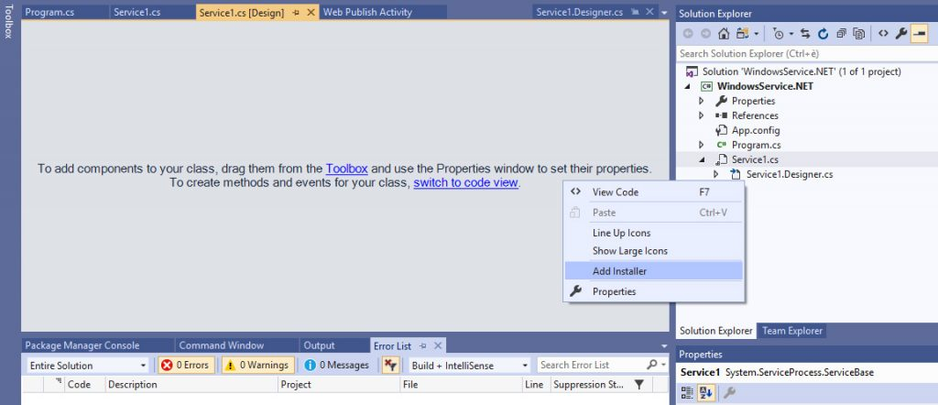
Create the Windows Service Project
Steps:Create New Project->Windows Service
Create an Installer
Def:component to register our Service with the Service Control Manager.
Steps:

Slide 3
Right click Add Installer in blank area
new ProjectInstaller.cs file will be added to the project
Save, then open the ProjectInstaller.Designer.cs file

Slide 4
Configure the Installer
Code to use Local system A/C:
Locate the lines defining the Username and Password (both set to null by default) and add the following line right above them to make our service use the LocalSystem account context:
this.serviceProcessInstaller1.Account = System.ServiceProcess.ServiceAccount.LocalSystem;
Define Service Name:
Right after that, locate the line of code defining the ServiceName and change it accordingly:
this.serviceInstaller1.ServiceName = "WindowsService.NET";
Display Name and a Description:
this.serviceInstaller1.DisplayName = "WindowsService.NET";
this.serviceInstaller1.Description =
"A sample Windows Service boilerplate written in C# using NET Framework and VS2019";

Slide 5
Initialize Component Coding
private void InitializeComponent()
{
this.serviceProcessInstaller1 = new System.ServiceProcess.ServiceProcessInstaller();
this.serviceInstaller1 = new System.ServiceProcess.ServiceInstaller();
//
// serviceProcessInstaller1
//
this.serviceProcessInstaller1.Account =
System.ServiceProcess.ServiceAccount.LocalSystem;
this.serviceProcessInstaller1.Password = null;
this.serviceProcessInstaller1.Username = null;
//
-contd
Notes:
1
2
3
4
5
6
7
8
9
10
11
12
13
14
15
16
17
18
19
20
21
22
23
24
25
private void InitializeComponent()
{
this.serviceProcessInstaller1 = new System.ServiceProcess.ServiceProcessInstaller();
this.serviceInstaller1 = new System.ServiceProcess.ServiceInstaller();
//
// serviceProcessInstaller1
//
this.serviceProcessInstaller1.Account =
System.ServiceProcess.ServiceAccount.LocalSystem;
this.serviceProcessInstaller1.Password = null;
this.serviceProcessInstaller1.Username = null;
//
// serviceInstaller1
//
this.serviceInstaller1.ServiceName = "WindowsService.NET";
this.serviceInstaller1.DisplayName = "WindowsService.NET";
this.serviceInstaller1.Description =
"A sample Windows Service boilerplate written in C# using NET Framework and VS2019";
//
// ProjectInstaller
//
this.Installers.AddRange(new System.Configuration.Install.Installer[] {
this.serviceProcessInstaller1,
this.serviceInstaller1});
}

Slide 6
// serviceInstaller1
//
this.serviceInstaller1.ServiceName = "WindowsService.NET";
this.serviceInstaller1.DisplayName = "WindowsService.NET";
this.serviceInstaller1.Description =
"A sample Windows Service boilerplate written in C# using NET Framework and VS2019";
//
// ProjectInstaller
//
this.Installers.AddRange(new System.Configuration.Install.Installer[] {
this.serviceProcessInstaller1,
this.serviceInstaller1});
}
That’s it for the installer: now let’s switch to the Windows Service code itself.

Slide 7
Create a sample recurring task
Open the Service1.cs file and switch to Code View
the Service1() method, aka the constructor, which internally calls the InitializeComponents() method that we modified in the previous paragraph.
The OnStart() method, which is called once when the service is started.
The OnStop() method, which will be called once when the service is stopped.
Add the following code below given in notes
Notes:
public partial class Service1 : ServiceBase
{
Timer Timer = new Timer();
int Interval = 10000; // 10000 ms = 10 second
public Service1()
{
InitializeComponent();
this.ServiceName = "WindowsService.NET";
}
protected override void OnStart(string[] args)
{
WriteLog("Service has been started");
Timer.Elapsed += new ElapsedEventHandler(OnElapsedTime);
Timer.Interval = Interval;
Timer.Enabled = true;
}
private void OnElapsedTime(object source, ElapsedEventArgs e)
{
WriteLog("{0} ms elapsed.");
}
protected override void OnStop()
{
Timer.Stop();
WriteLog("Service has been stopped.");
}
private void WriteLog(string logMessage, bool addTimeStamp = true)
{
var path = AppDomain.CurrentDomain.BaseDirectory;
if (!Directory.Exists(path))
Directory.CreateDirectory(path);
var filePath = String.Format("{0}\\{1}_{2}.txt",
path,
ServiceName,
DateTime.Now.ToString("yyyyMMdd", CultureInfo.CurrentCulture)
);
if (addTimeStamp)
logMessage = String.Format("[{0}] - {1}",
DateTime.Now.ToString("HH:mm:ss", CultureInfo.CurrentCulture),
logMessage);
File.AppendAllText(filePath, logMessage);
}
}
The Timer private variable, which host a standard timer (from System.Timers namespace).
The Interval private variable, which globally defines the timer interval in milliseconds.
The OnElapsedTime() private method, which will be called upon each timer interval cycle.
The WriteLog() private method, which logs a custom log message to a daily log file persisted on disk: such file will be created within the folder that hosts the service executable.
A minimal implementation in the existing OnStart() and OnStop() methods to put everything together.

Slide 8
Installing the Service

